Slide 1
e-Tuition THE SQUARES - 01
Contributions of different members
Aninda Sadman-18101617: Requirement Analysis , ER diagram and Class diagram
Zarin Tahia Hossain -18101184: Intro about Project, System Request and Sequence Diagram
Taslim Ahmed Taseeb-18101443: Use-case diagram, WND diagram and Activity diagram
Notes:
1

Slide 2
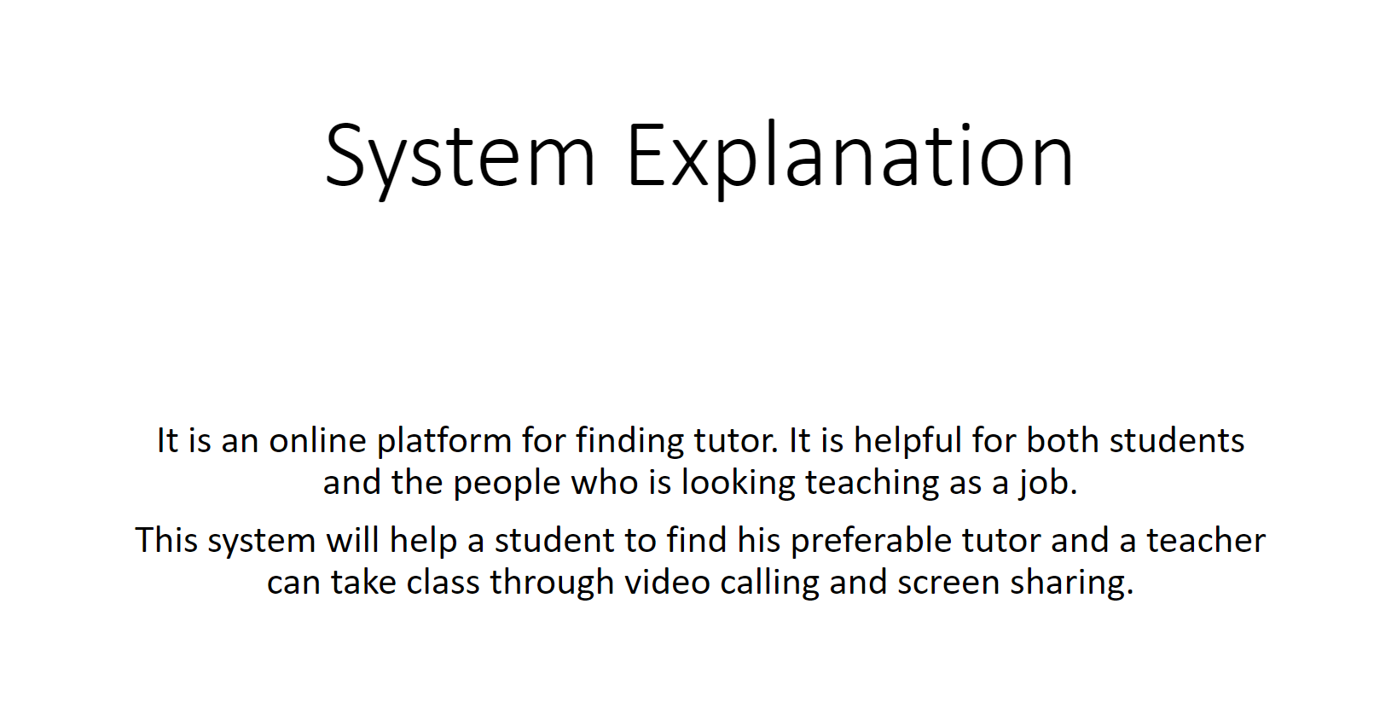
2

Slide 3
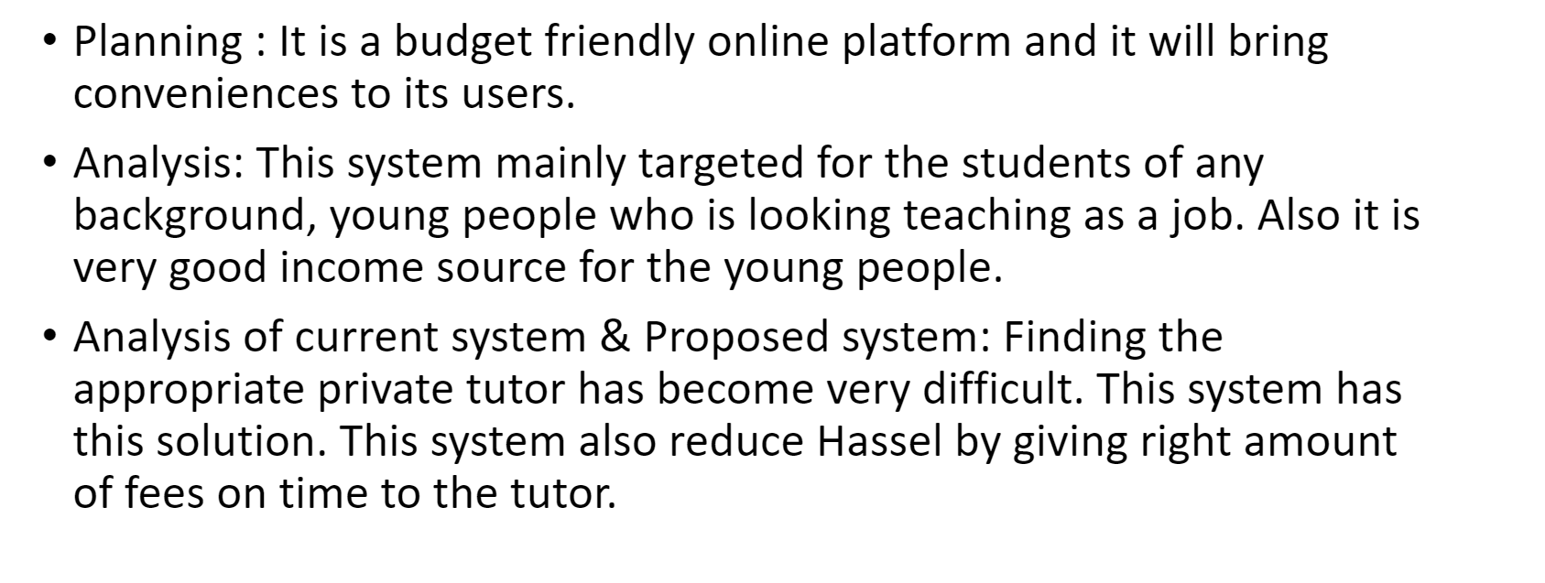
ABOUT OUR PROJECT

Slide 4
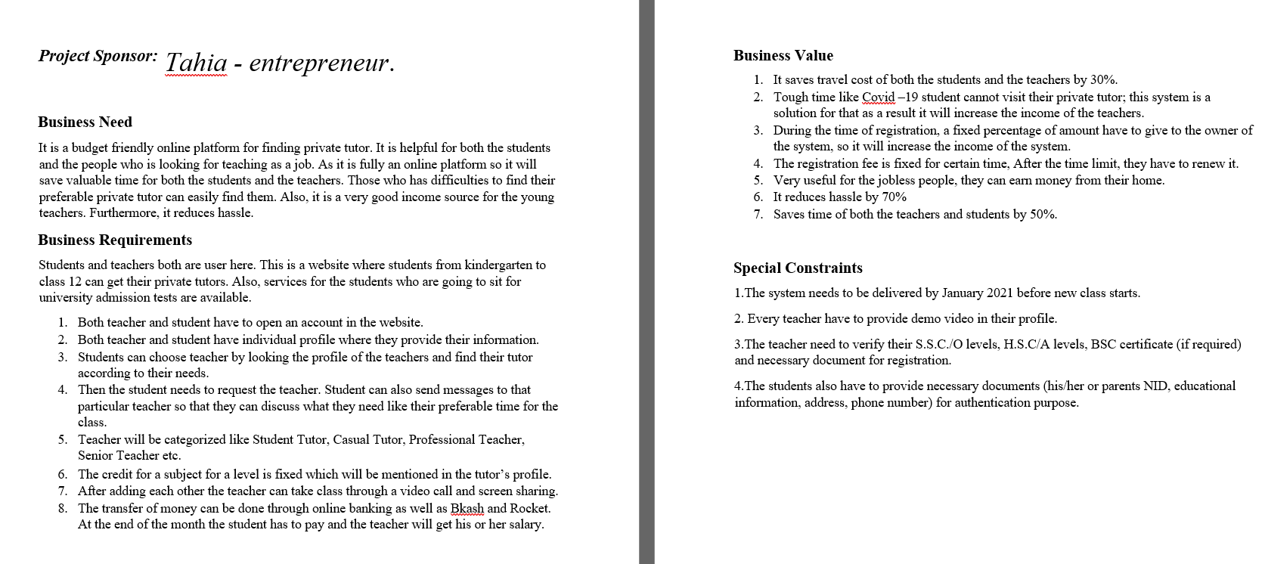
System Request

Slide 5
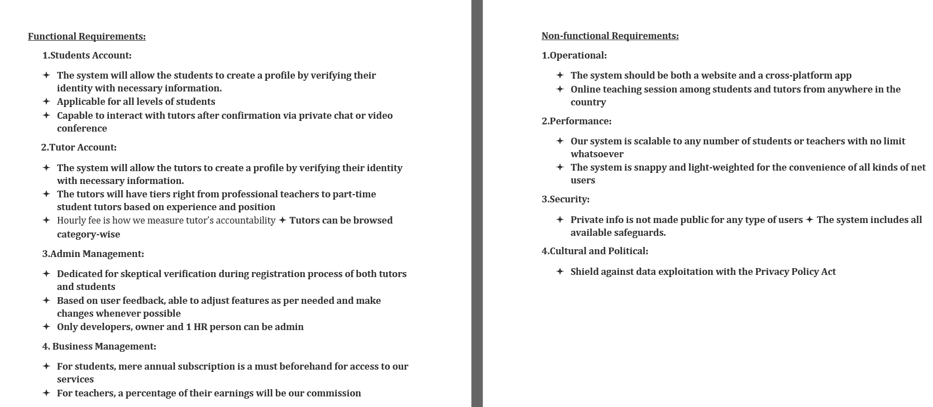
Requirement analysis
5

Slide 6
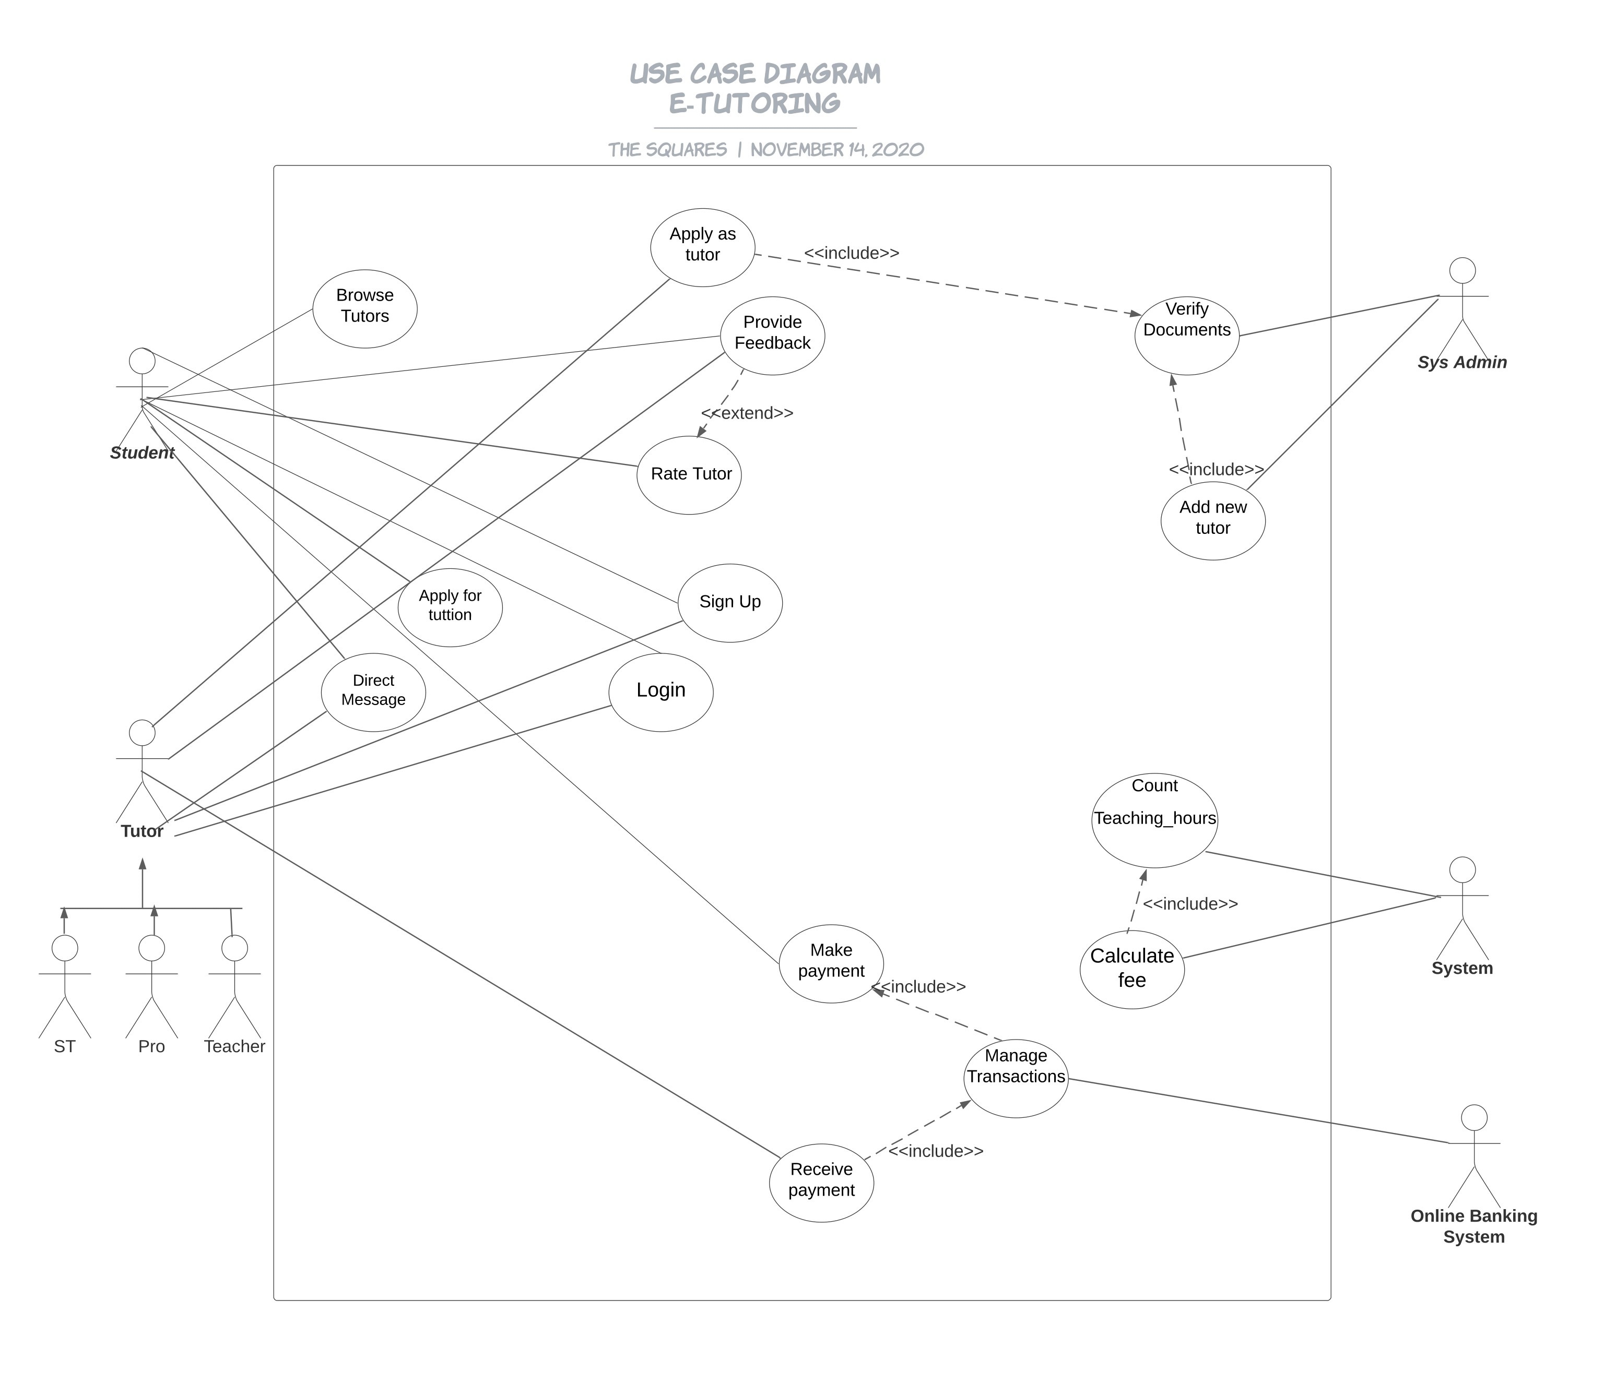
USE Case Diagram
6

Slide 7
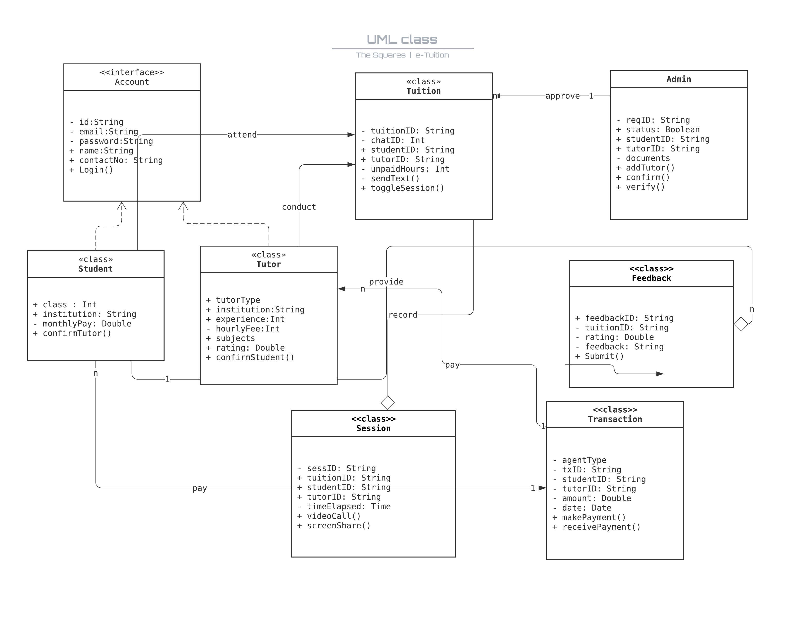
Class Diagram
7

Slide 8
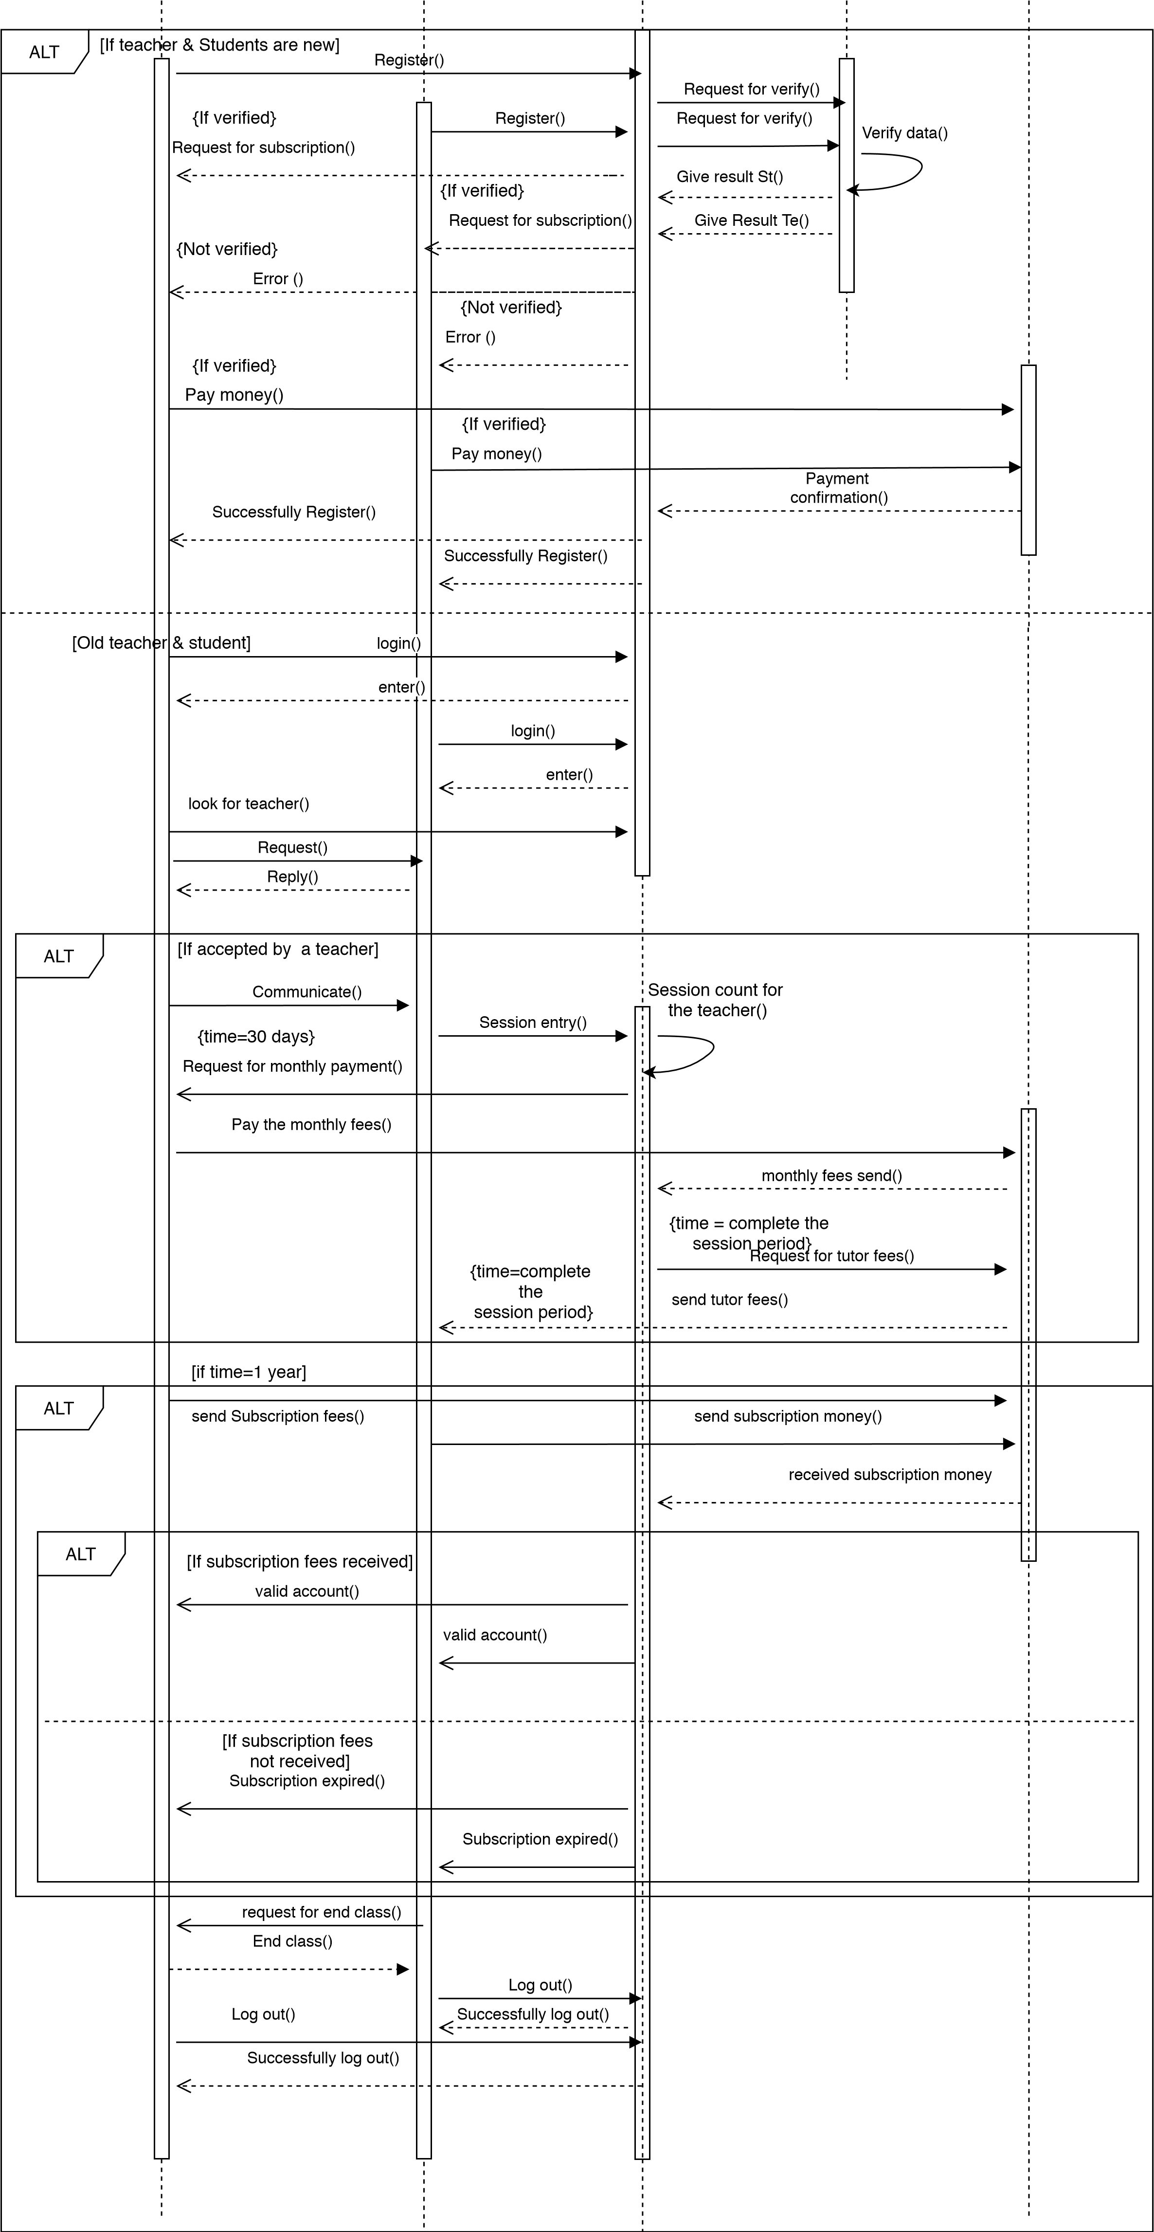
Sequence Diagram
8

Slide 9
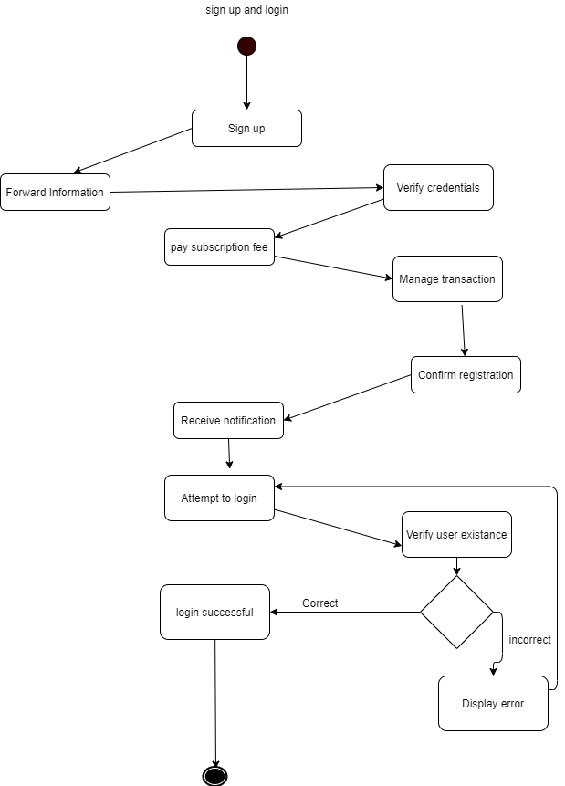
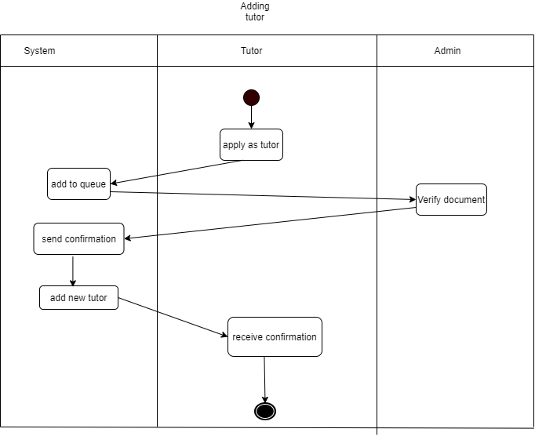
Activity Diagram
9

Slide 10
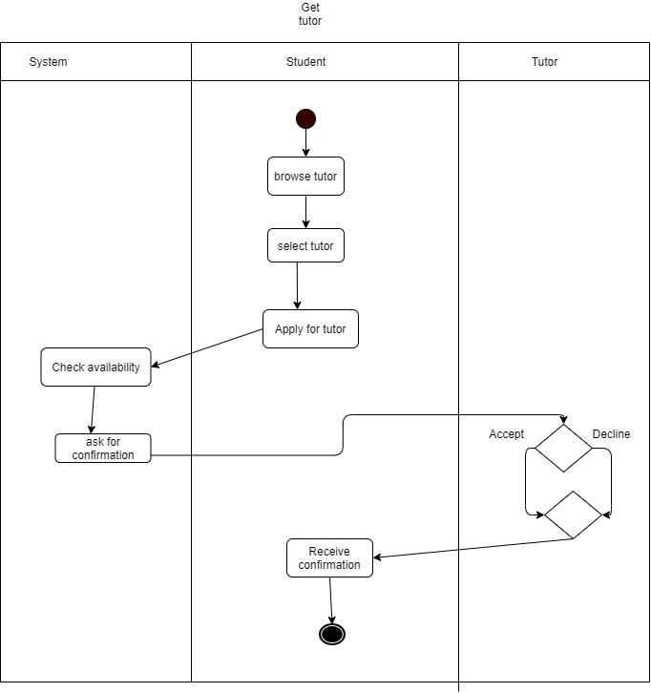
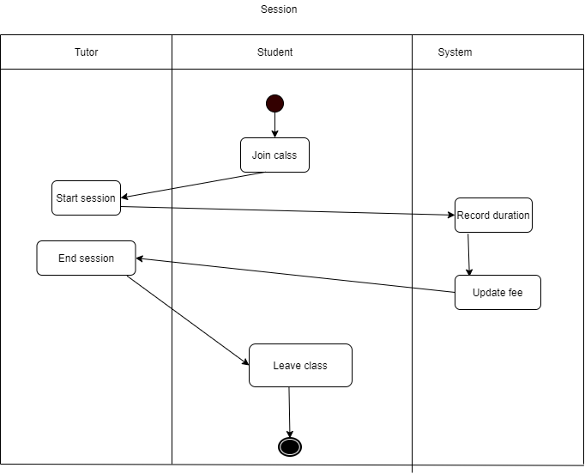
Activity Diagram
10

Slide 11
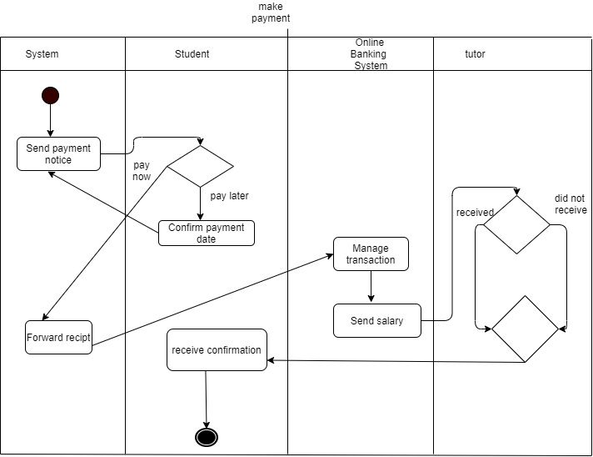
Activity Diagram
11

Slide 12
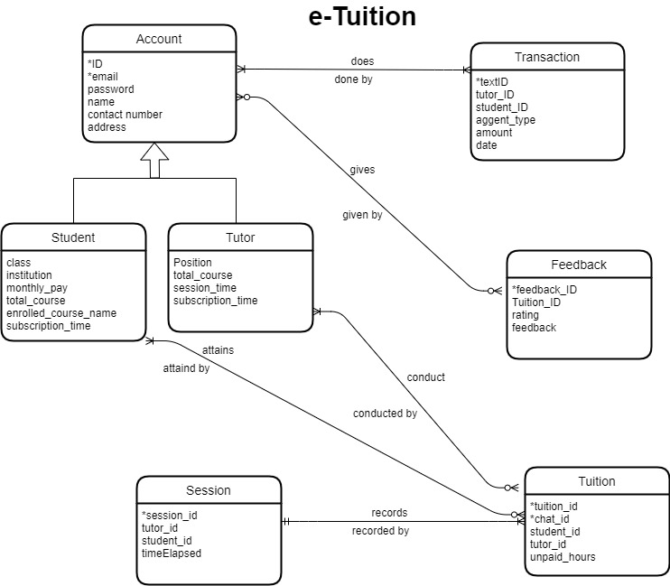
ER
Diagram
12

Slide 13
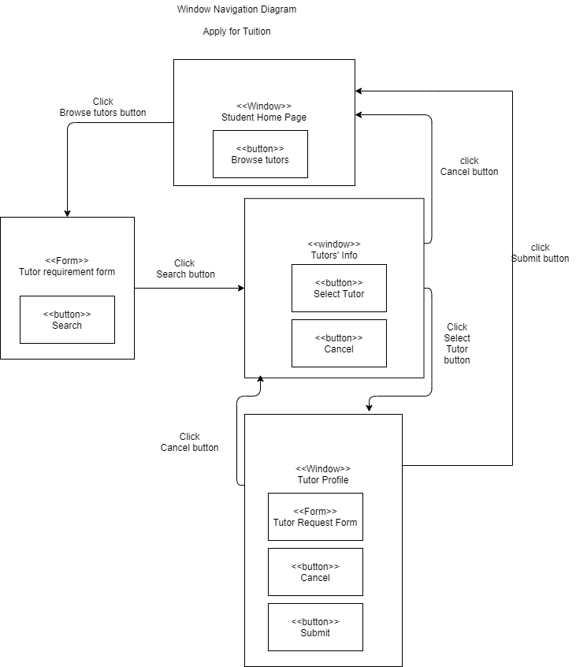
WND Diagram
13

Slide 14
THANK YOU
14

